Slide 1



PRESENTATION
2023 Report on Global Plastic Waste
ECOGUARD ALLIANCE NGO

Slide 2

Table of Content
Introduction
Project Objectives
Data Overview
Analysis
Insights
Recommendation
Conclusion

Slide 3
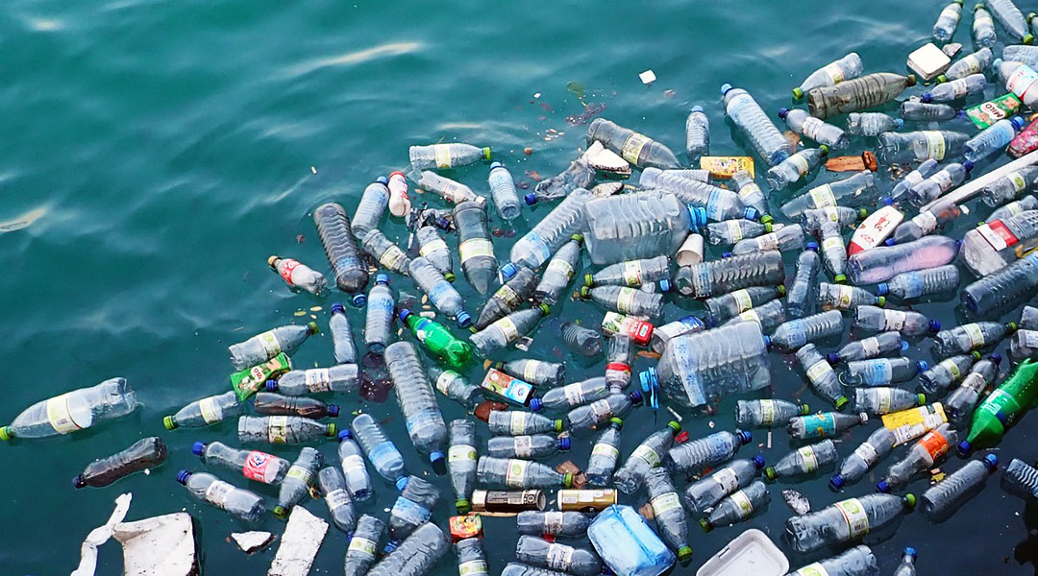
Introduction
Plastic waste has become one of the most pressing environmental challenges of our time, with millions of tons being produced annually.
Humans currently produce more than 350 million metric tons of plastic waste annually.

Slide 4
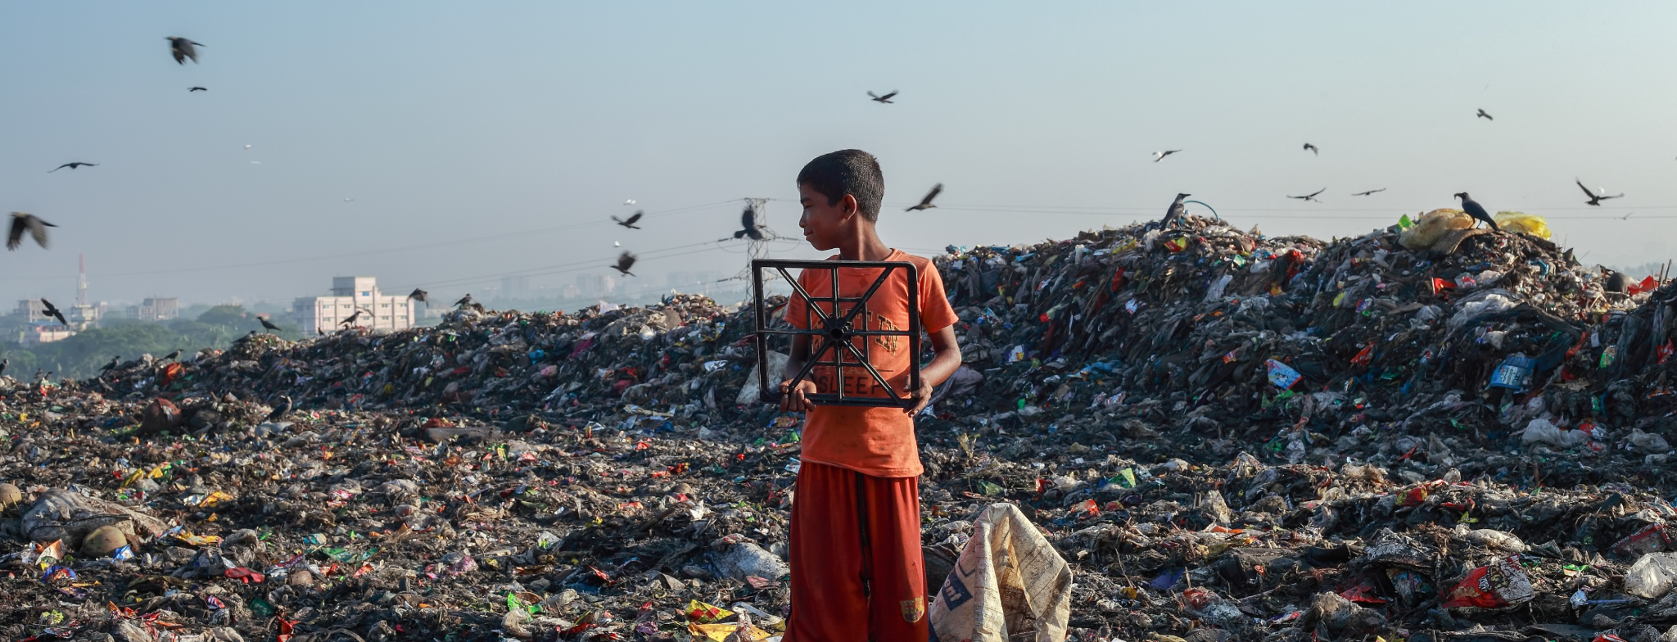
Project Objectives
Understanding how much plastic waste is generated in the year
Identify the major contributors to plastic waste
Examine countries production and recycling rates in the year.
Propose data-driven solutions for improved plastic waste management.

Slide 5
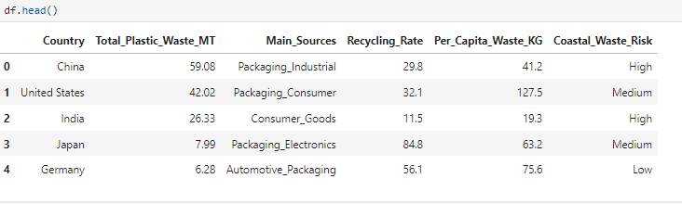
Data Overview
The dataset used for the analysis contains the following key columns:
Country
Total_Plastic_Waste_MT
Main_Sources
Recycling_Rate
Per_Capita_Waste_KG
Coastal_Waste_Risk

Slide 6

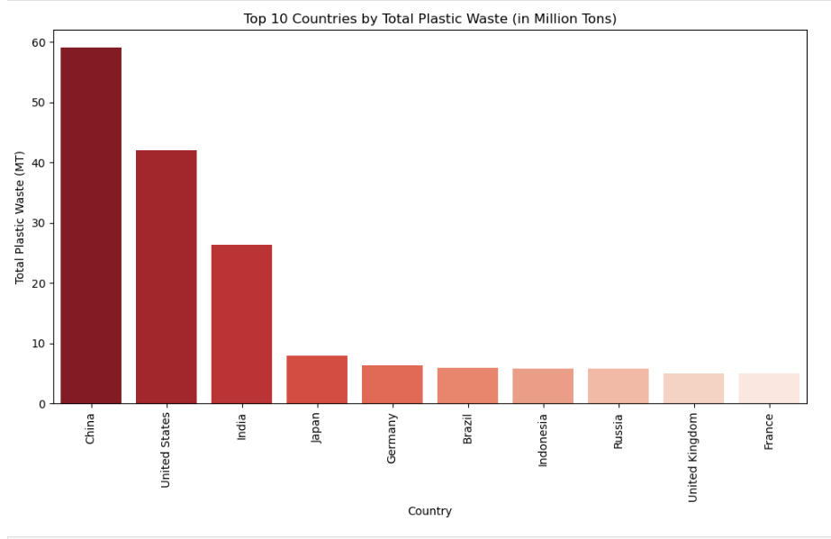
Analysis
The top 10 producers of Plastic waste globally, with China with 59.08 million metric tons leading followed by the United States with 42.02 million metric tons and India with 26.33 million metric tons.

Slide 7
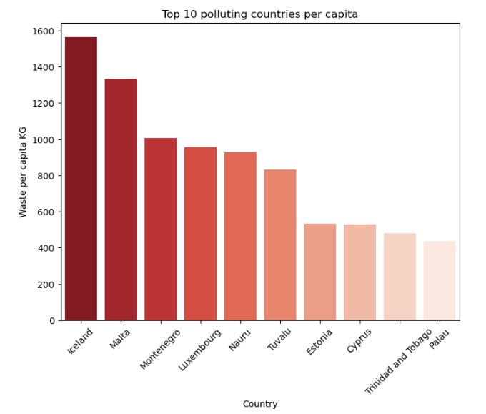
Analysis
This shows the top 10 Countries that generated the most single-use plastic waste per capita in 2019, measured in kilograms per person. With Iceland having 1564.4kg ,followed by Malta having 1331.5kg and Montenegro having 1004.8kg per capita.

Slide 8
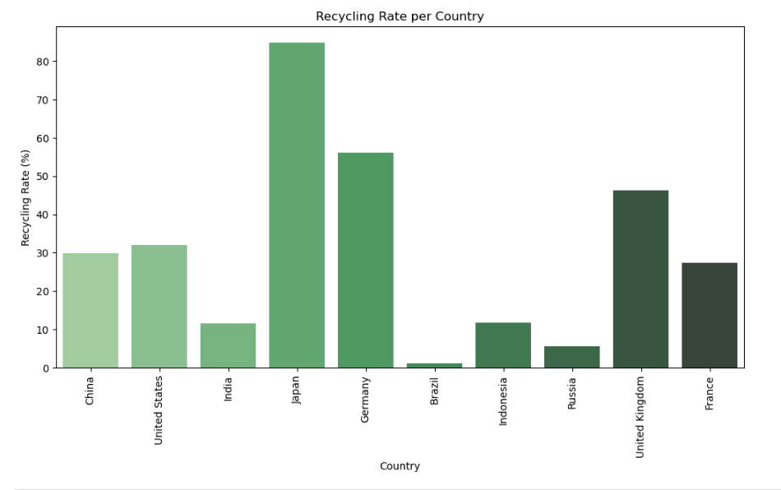
Analysis
From, the Visuals, Japan has 84.8% rate of recycling, folloewd by Germany with 56.1% and then the United Kingdom with 46.2% being recycled out of the total plastic the nation produced.

Slide 9
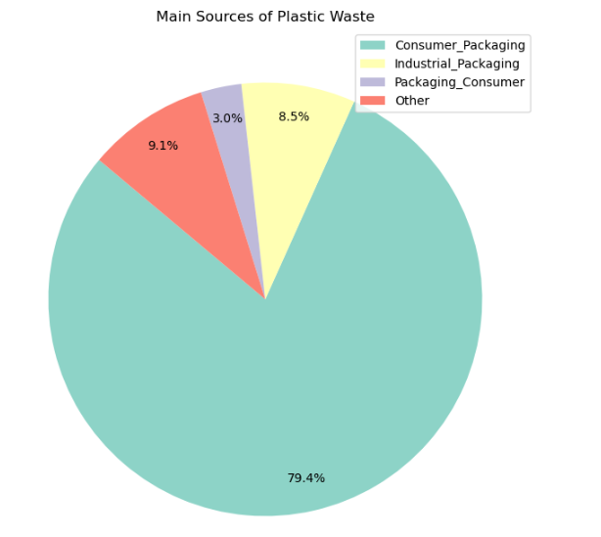
Analysis
These are the major sources of Plastic waste found globally in 2023, with Consumer Packaging being 79% of the source .

Slide 10
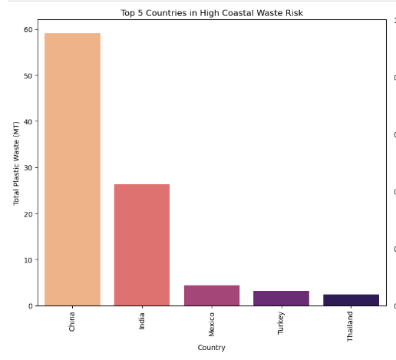
Analysis
The top 5 countries at high coastal waste risk, as these countries are alond coastal lines of their continents, the have more risk of having plastic waste pollute and occupy their shore.

Slide 11
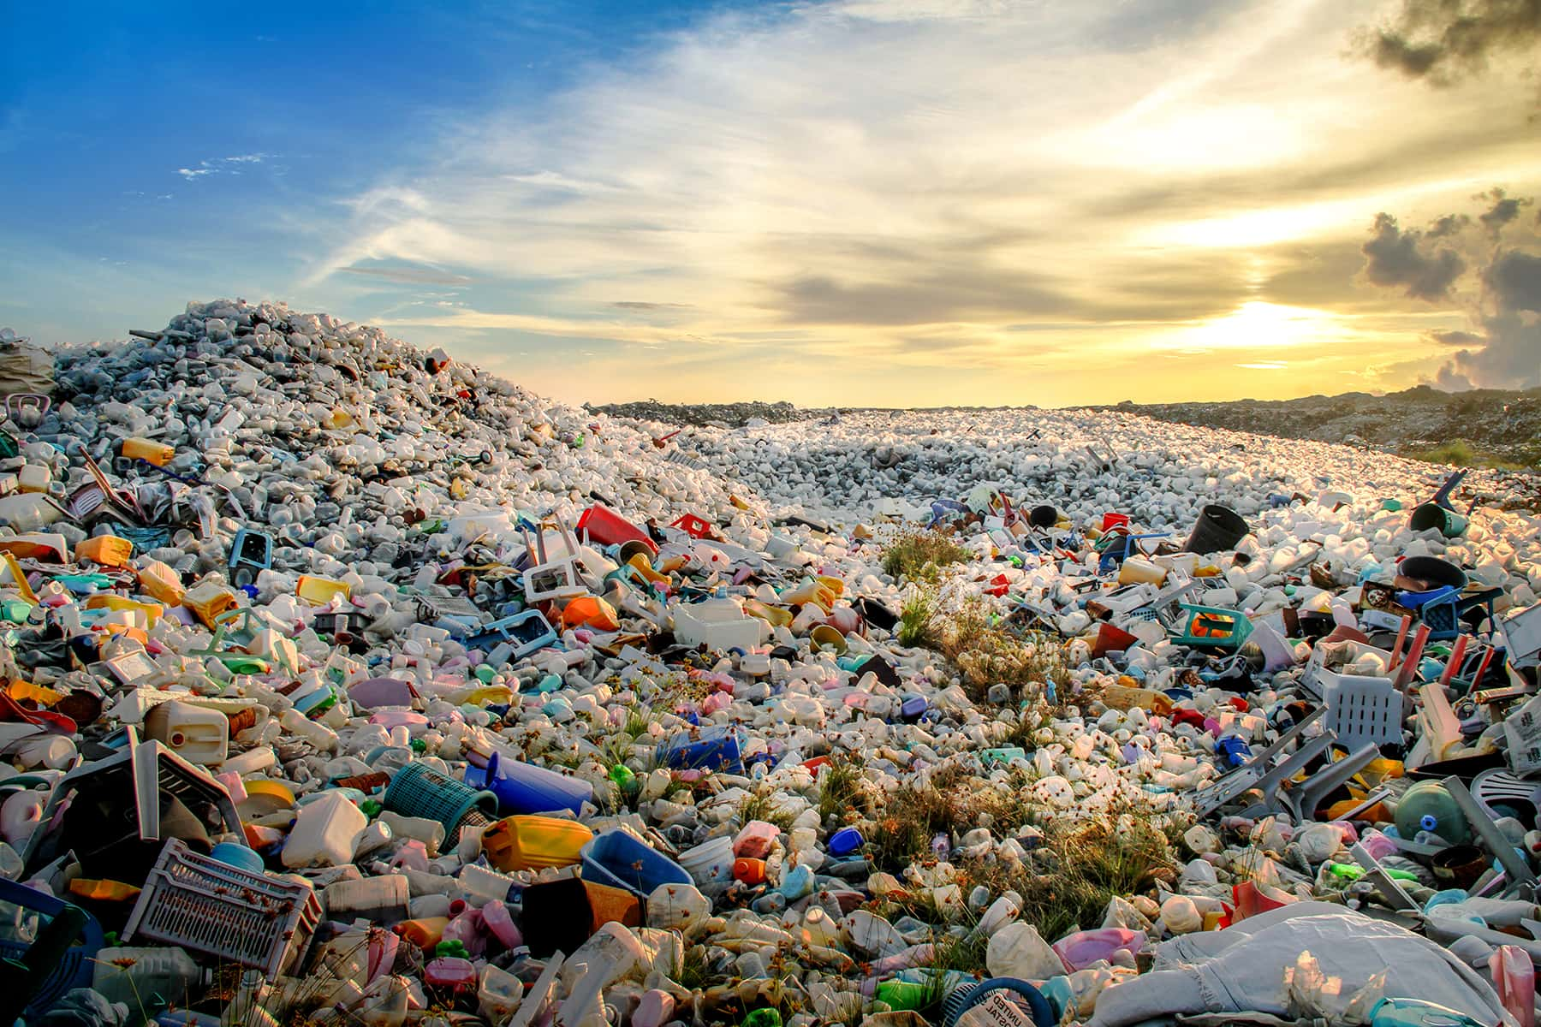
Recommendation
Countries with high plastic waste production should implement stricter regulations, promote sustainable packaging, and incentivize businesses to reduce plastic use.
Nations with high coastal waste risk should invest in advanced recycling technologies, enforce waste segregation policies, and promote circular economy models to minimize environmental impact.
Governments can learn from high-performing nations like Japan and Singapore by adopting policies that encourage recycling, impose plastic bans, and integrate innovative waste management technologies.

Slide 12
Conclusion
Addressing global plastic waste requires a data-driven, collaborative approach that integrates policy reforms, innovative recycling technologies, and sustainable consumer practices. By learning from successful waste management models and implementing targeted interventions, we can significantly reduce plastic pollution and protect our environment for future generations.

